Slide 1
Introduction to Programming
Lecture 10

Slide 2
Recursive Functions

Slide 3
A recursive function
A Recursive function can be defined as a function that calls itself.
The essence of recursion – solving a larger problem by breaking it down into smaller instances of the same problem.

Slide 4
Need for a recursive function
A recursive function is a function that solves a problem by solving smaller instances of the same problem.
This technique is often used in programming to solve problems that can be broken down into simpler, similar subproblems.

Slide 5
Components of a Recursive Function
Base case:
Every recursive function must have a base case.
The base case is the simplest scenario that does not require further recursion.
This is a termination condition that prevents the function from calling itself indefinitely.
Without a proper base case, a recursive function can lead to infinite recursion.
Recursive case:
In the recursive case, the function calls itself with the modified arguments.
The recursive case should move closer to the base case with each iteration.

Slide 6


Components of a Recursive function
Base case:
What makes the code stop?
Recursive case:
The function calls itself with modified arguments.

Slide 7
Example 1 : Factorial
A factorial is a mathematical operation that you like this: n!. It represents the multiplication of all numbers between 1 and n.
5!
= 5 x 4 x 3 x 2 x 1 = 120
4!
= 4 x 3 x 2 x 1 = 24
0! = 1
1! = 1
5!
= 5 x 4! = 120

Slide 8


Example 1: Factorial using loops
int factorial(int n)
{
int result = 1;
while (n > 0)
{
result = result * n;
n = n - 1;
}
return result;
}
When to stop?
when n=1
This is the base case
What is changing every iteration?
Answer: multiplying with n decremented by 1
i.e: multiply by the factorial of n-1
int main()
{
cout<<factorial(5);
return 0;
}

Slide 9
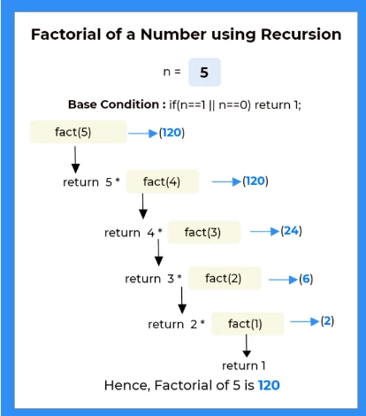

Example 1: Factorial using recursion
A sketch for tracing the factorial of 5
int factorial(int n)
{
if (n==1)
return 1;
return n * factorial(n - 1);
}
Base case
int main()
{
cout<<factorial(5);
return 0;
}
120

Slide 10
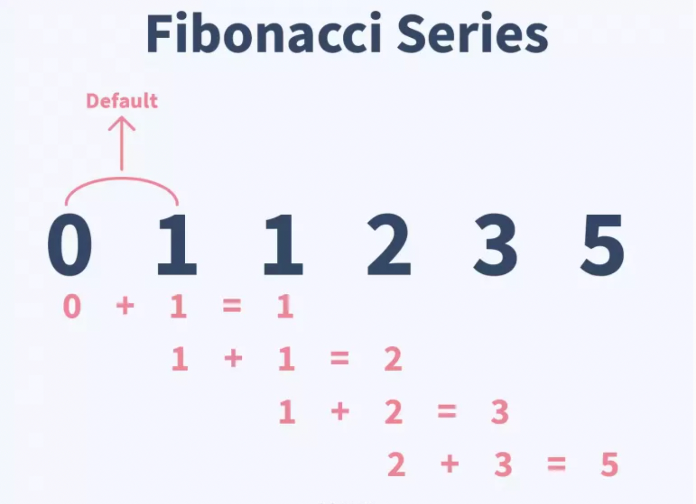
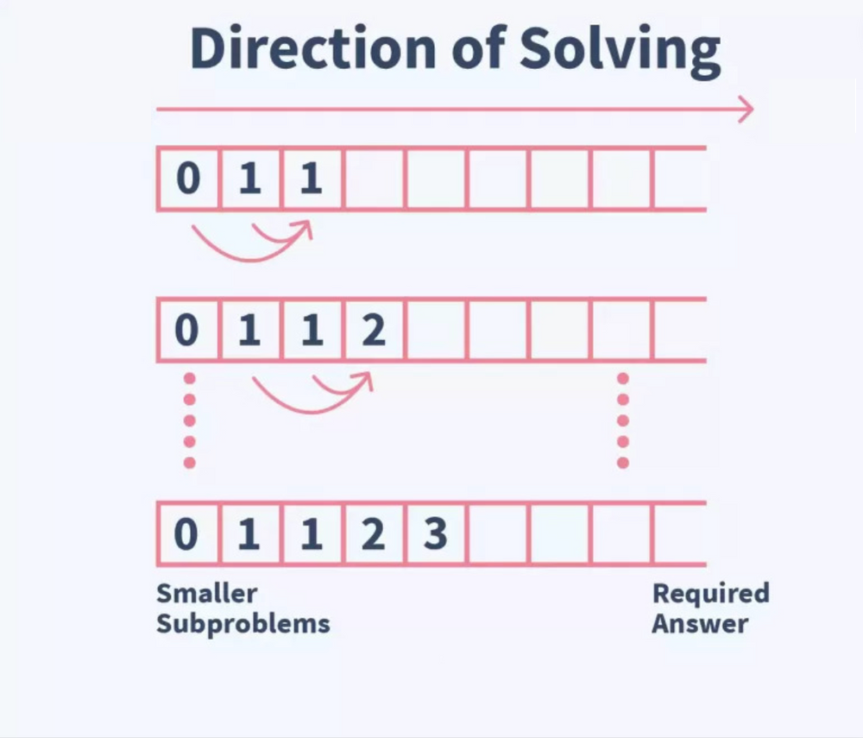
Example 2 : Fibonacci series
Each number is the sum of values at the previous two numbers.
The first two numbers are 0 and 1.
Fibonacci of the 10th term is:
0 1 1 2 3 5 8 13 21 34 55

Slide 11
Example 2 : Fibonacci series
An example to calculate the series till the nth term
int fibonacci(int n)
{
if (n == 0)
return 0;
if (n == 1)
return 1;
return fibonacci(n - 1) + fibonacci(n - 2);
}
2 base cases
int main()
{
cout<< fibonacci(10);
return 0;
}
55

Slide 12
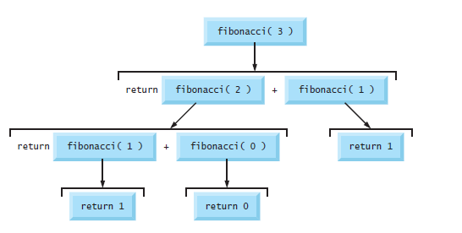







Example 2 : Fibonacci series
An example to calculate the series till the nth term
A sketch for tracing the Fibonacci of 3
int fibonacci(int n)
{
if (n == 0)
return 0;
if (n == 1)
return 1;
return fibonacci(n - 1) +
fibonacci(n - 2);
}
2
2
2 base cases
1
1
1
0

Slide 13
Example 3 : Towers of Hanoi
The Tower of Hanoi is a mathematical game or puzzle consisting of three rods and a number of disks of various diameters, which can slide onto any rod.
The puzzle begins with the disks stacked on one rod in order of decreasing size, the smallest at the top.
The objective of the puzzle is to move the entire stack to one of the other rods, obeying the following rules:[Only one disk may be moved at a time.
Each move consists of taking the upper disk from one of the stacks and placing it on top of another stack or on an empty rod.
No disk may be placed on top of a disk that is smaller than it.
https://yongdanielliang.github.io/animation/web/TowerOfHanoi.html

Slide 14
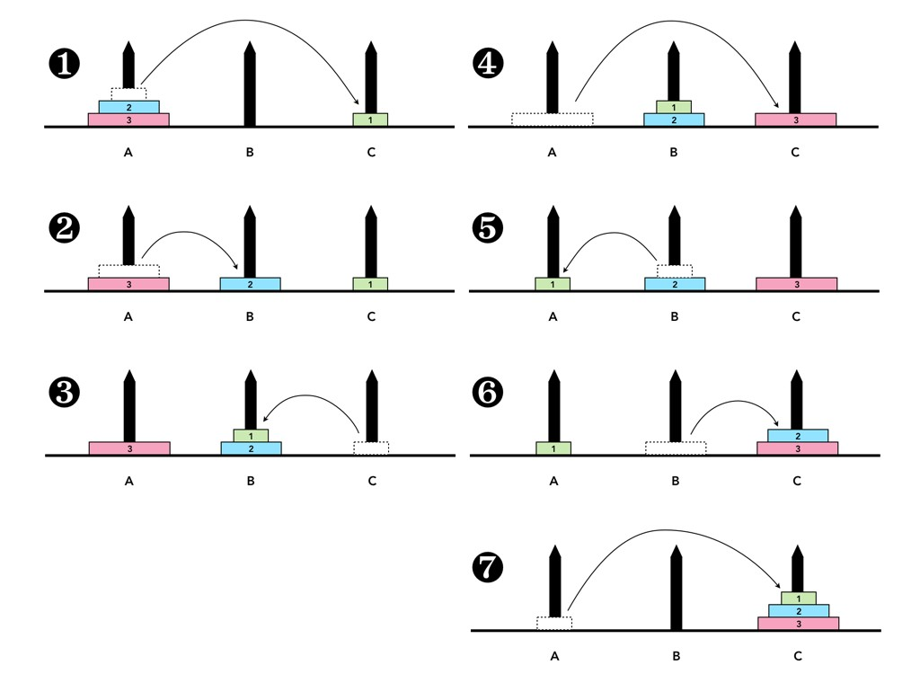

Slide 15
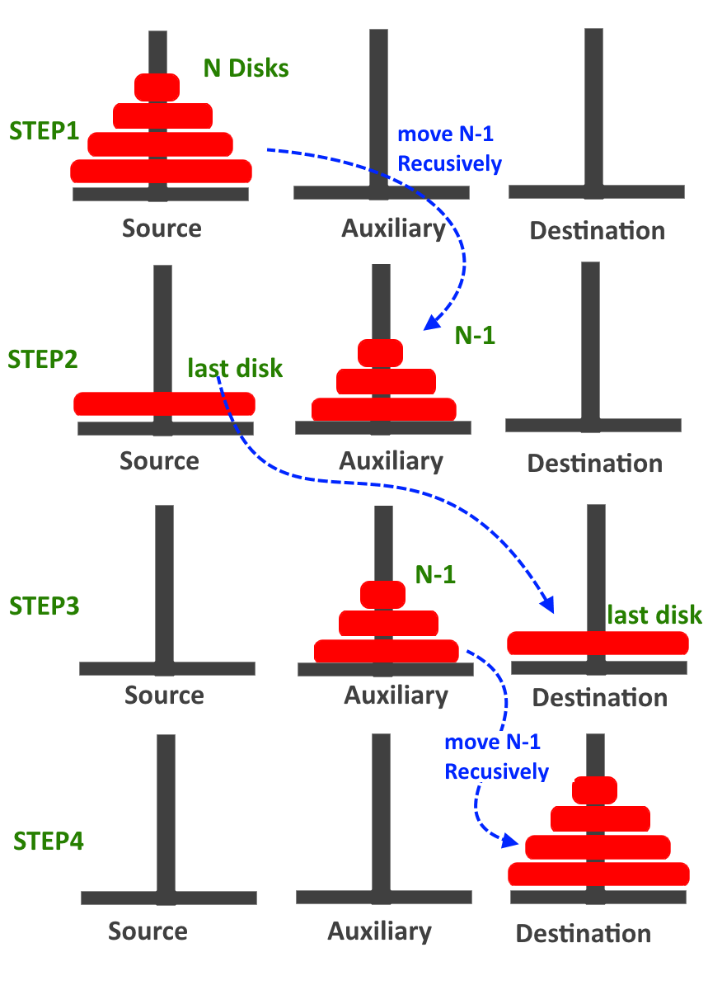
Example 3 : Towers of Hanoi
A recursive Outline for the solution of the problem
for N number of disks is as follows:
Move the top N-1 disks from peg A to peg B (using C as an auxiliary peg)
Move the bottom disk from peg A to peg C
Move N-1 disks from Peg B to Peg C (using Peg A as an auxiliary peg)
The pictorial representation of the recursive procedure for N=4 disks
Source: https://www.includehelp.com/data-structure-tutorial/tower-of-hanoi-using-recursion.aspx

Slide 16
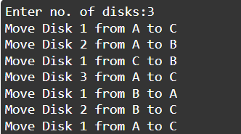
Example 3 : Towers of Hanoi
void TowersOfHanoi(int n, char Sour, char Aux, char Des)
{
if (n == 1) {
cout << "Move Disk " << n << " from " << Sour << " to " << Des << endl;
return;
}
TowersOfHanoi(n - 1, Sour, Des, Aux);
cout << "Move Disk " << n << " from " << Sour << " to " << Des << endl;
TowersOfHanoi(n - 1, Aux, Sour, Des);
}
int main()
{
int n;
cout << "Enter no. of disks:";
cin >> n;
TowersOfHanoi(n, 'A', 'B', 'C');
return 0;
}

Slide 17

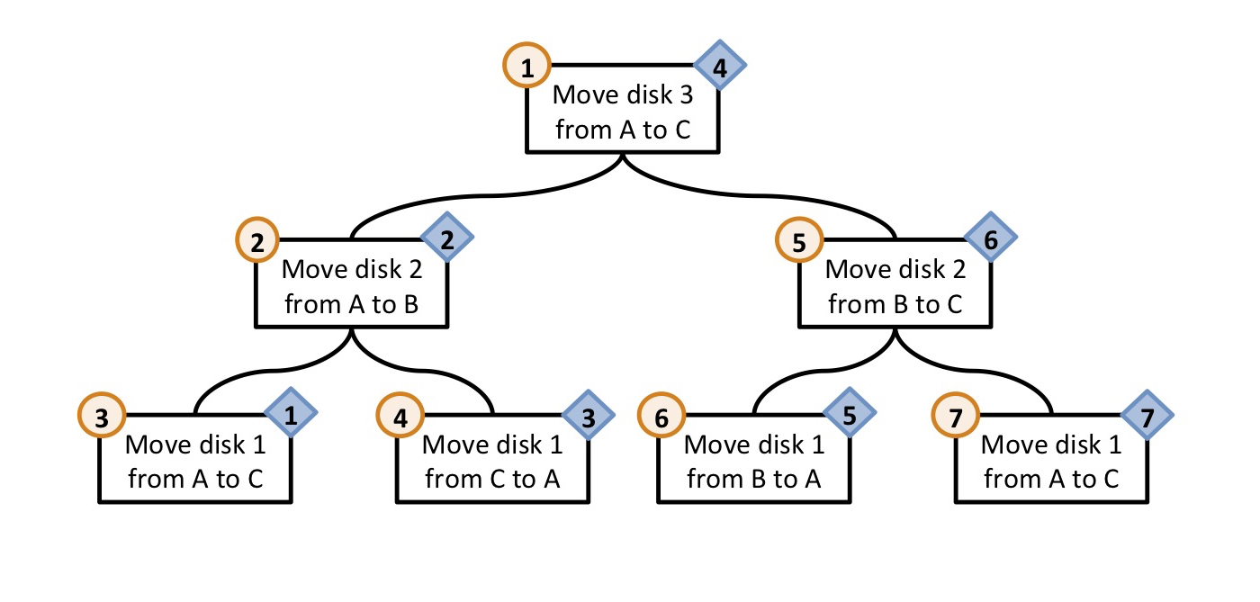
Disk 2 A->B
Disk 1
A->C
Print A->B
TowersOfHanoi(n - 1, Sour, Des, Aux);
cout << "Move Disk " << n << " from " << Sour << " to " << Des << endl;
TowersOfHanoi(n - 1, Aux, Sour, Des);

Slide 18

Thank You

